Slide 1
Logical Design
C393: Database Systems

Slide 2
Review

Slide 3
Lesson Objectives
Convert a conceptual design to a logical design

Slide 4

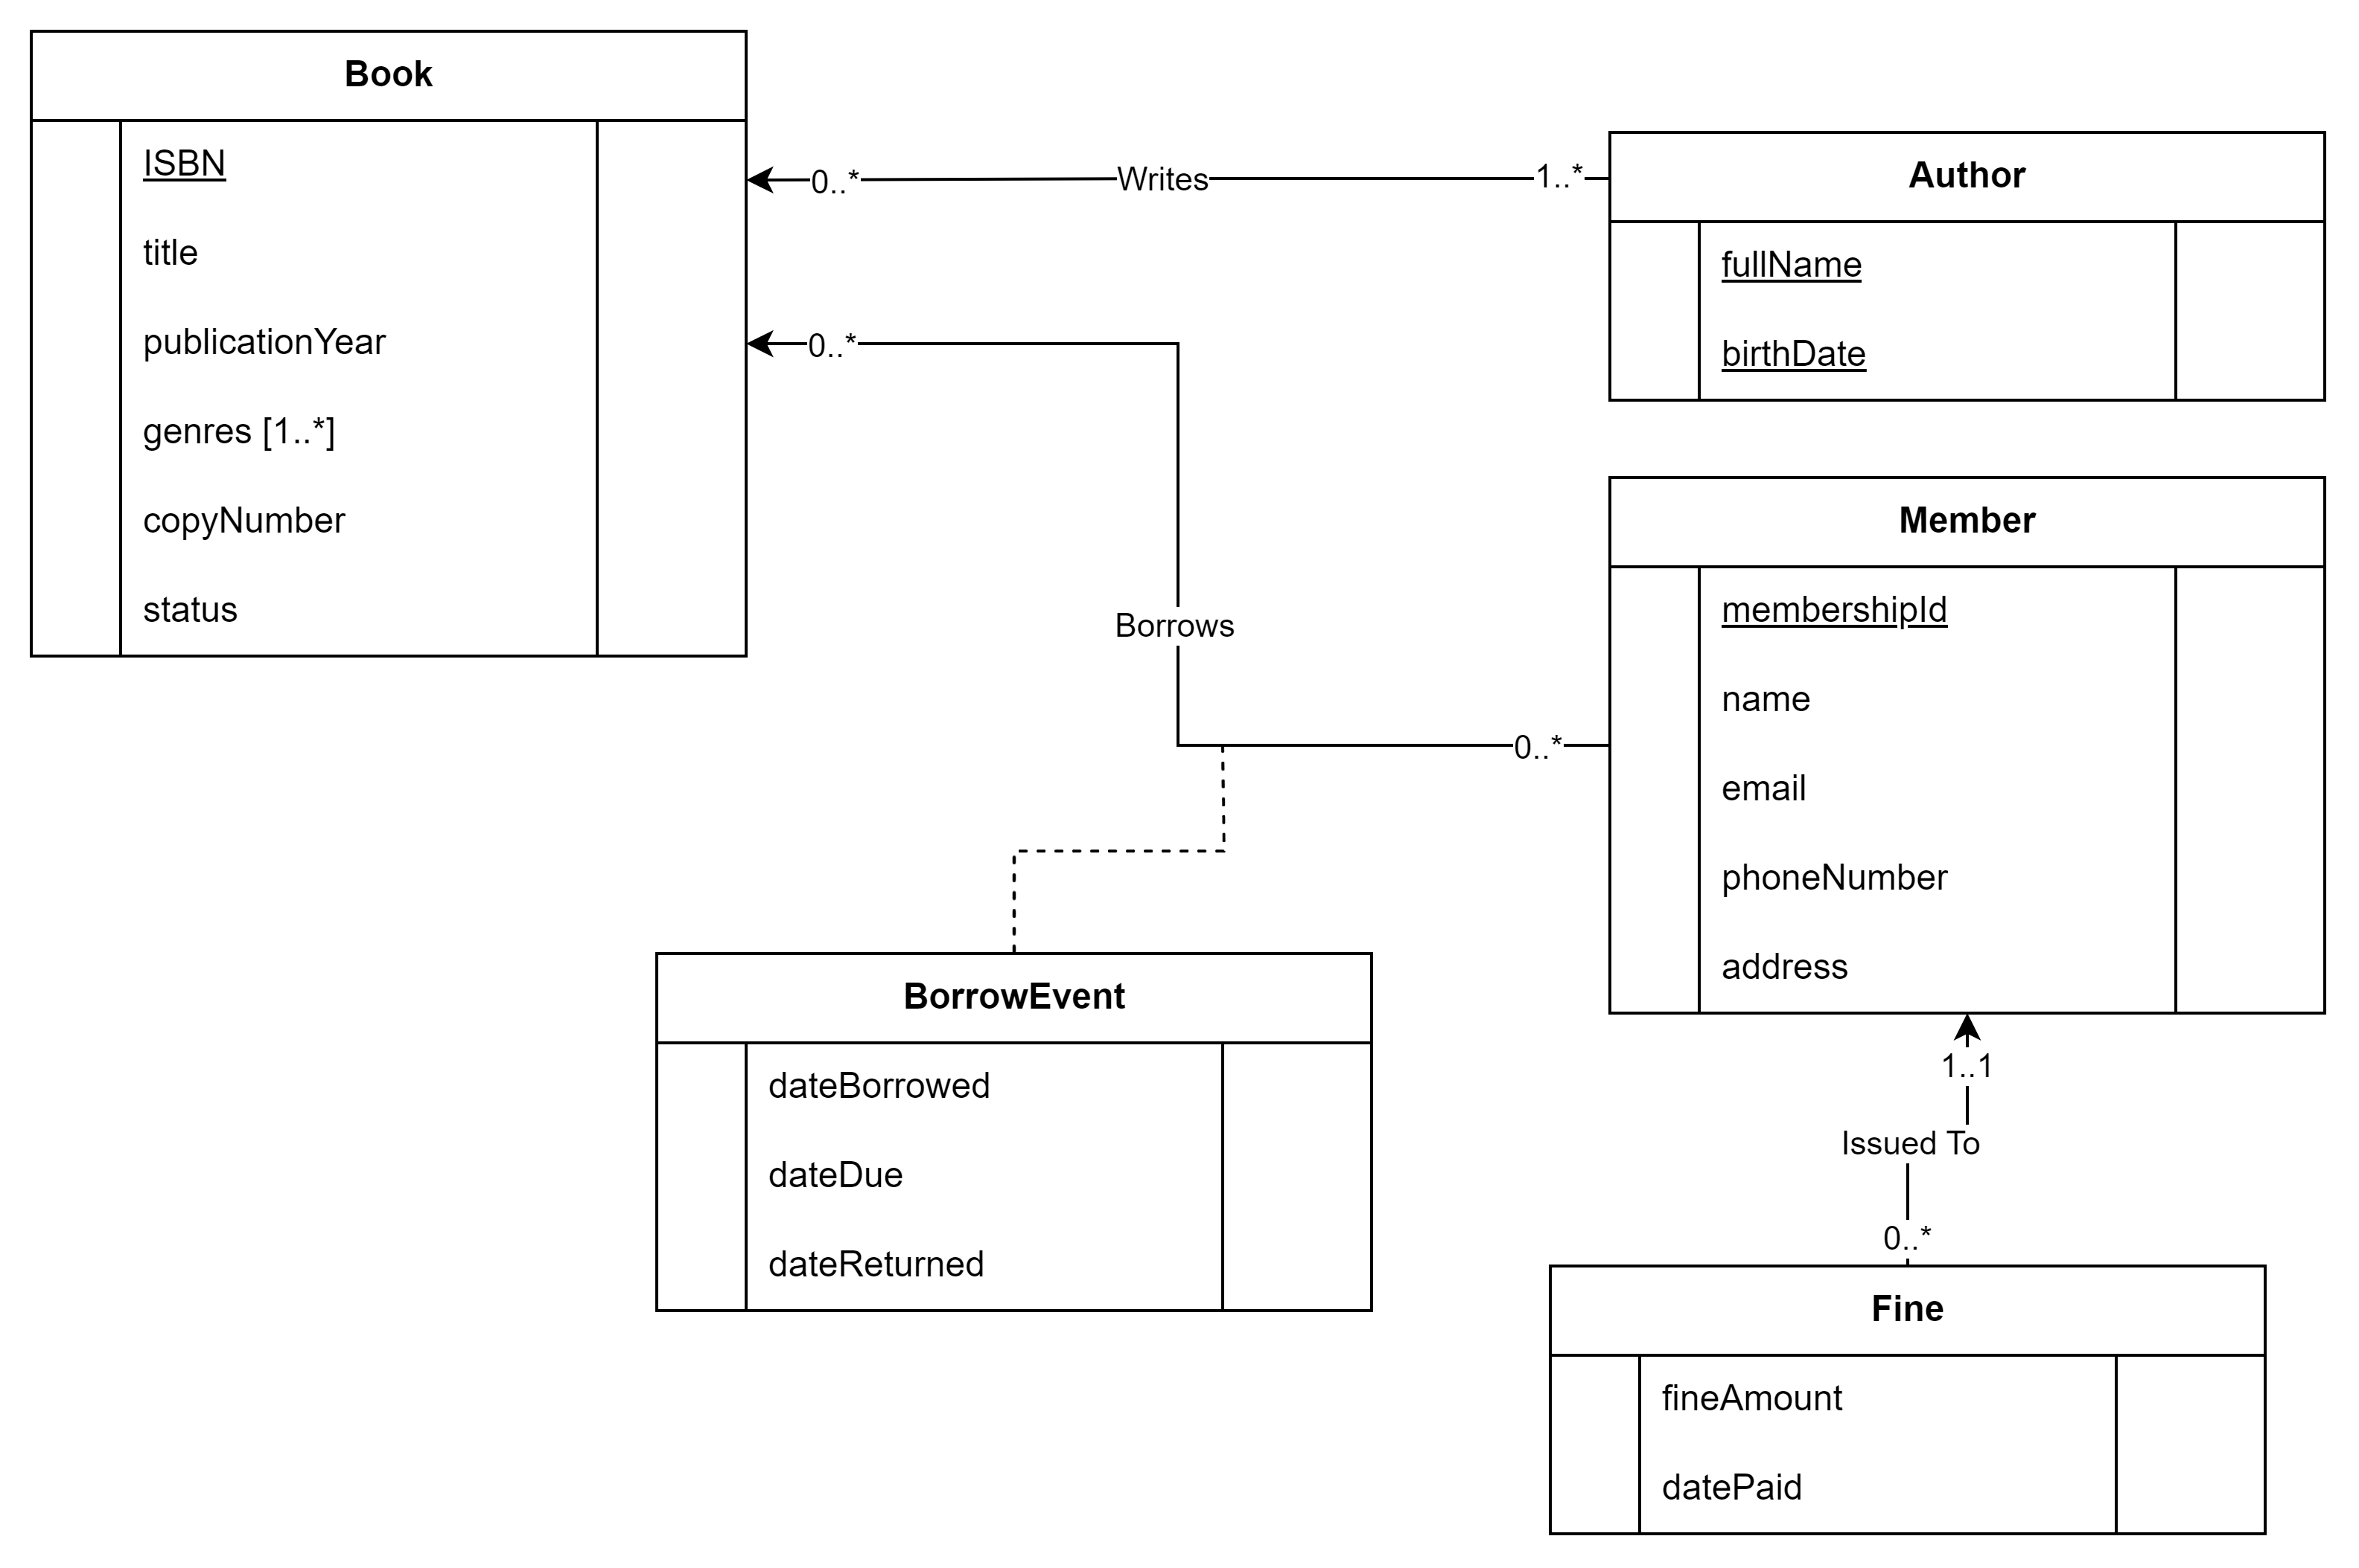
Library Concept Model
Notes:
Club, Cadet, Activity are entity classes
CompetitiveClub and NonCompetiveClub are entity classes that are special types of Club
Club has two associations with Cadet
cadetParticipatesInClub which is an Association Class; this is a Many-to-Many association
IsCadetInCharge; a cadet can be CIC of 0-to-many clubs, but a club can only have one CIC
Club has an association with Activity
participatesIn; this is a Many-to-Many association
The Data Model is useful, but we cannot create a database through this representation; we want to take this Data Model and translate it to a Relational Schema to create a database;

Slide 5
Conceptual Model to Logical Model
Derive relations
Validate using normalization
Validate against transactions
Notes:
Data Model on the left, Relational Schema on the right
Note we underline the primary key and remove any (PK) or <PK>
Required attributes are bolded
Data types and sizes (as required) are also indicated

Slide 6
Deriving Relations
Strong types
Weak types
1:*
1:1
Superclass/subclass
*:*
Complex relationships
Multi-valued

Slide 7
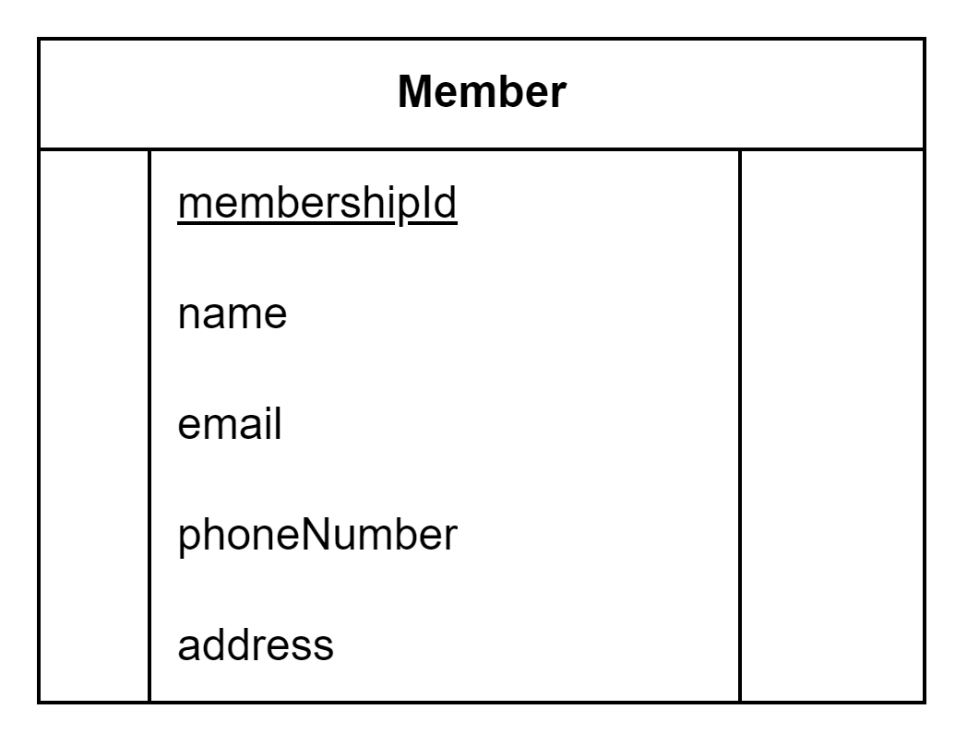
Strong types
Split composite attributes
Assign primary key or create if necessary
Notes:
Extract address to composite attributes

Slide 8
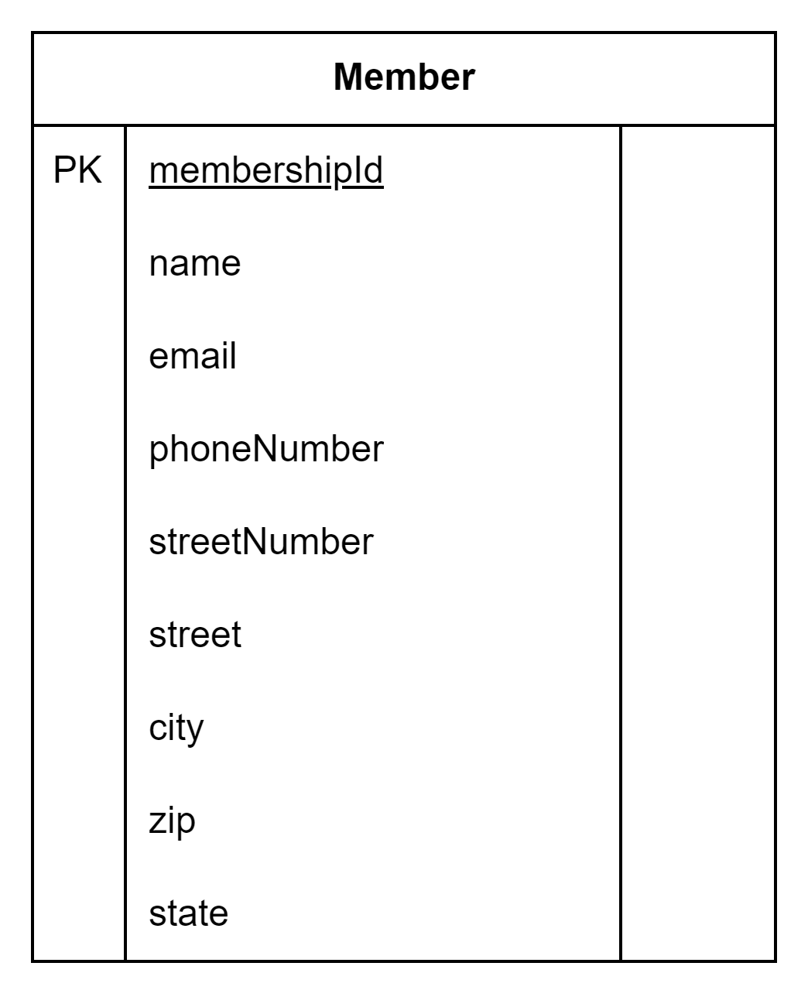
Strong types
Notes:
Extract address to composite attributes

Slide 9
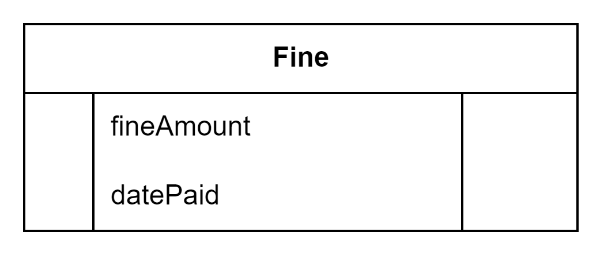
Weak Types
Cannot assign PKs until the relationships are established (next step)

Slide 10
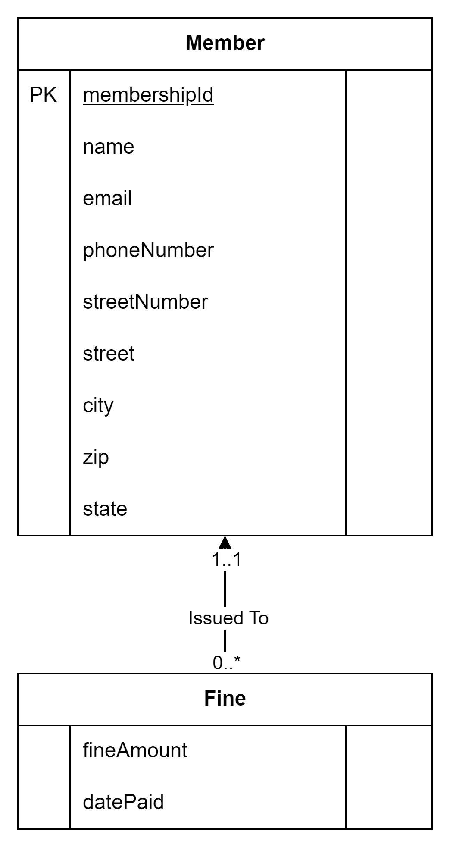
1:*
“one side” is the parent, “many” side is the child
Take PK(s) from parent and add it to child as FK(s)

Slide 11
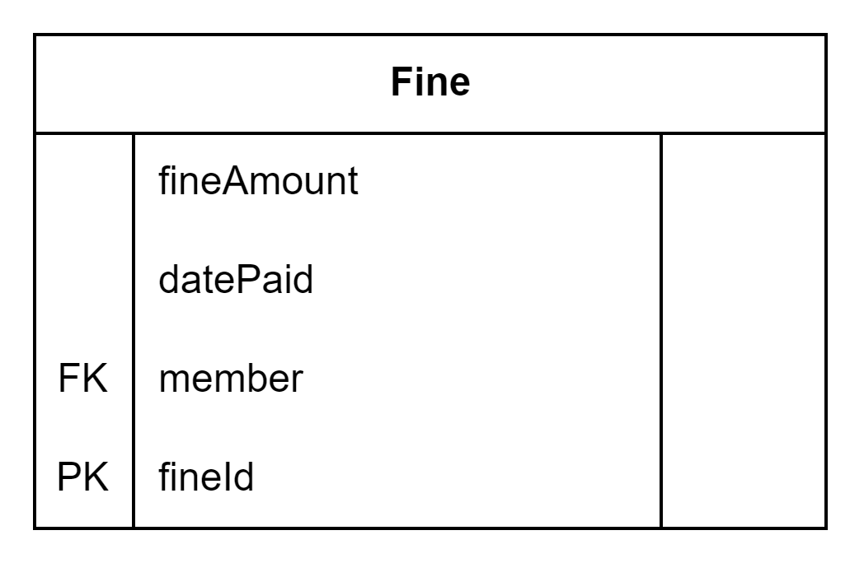
1:*

Slide 12
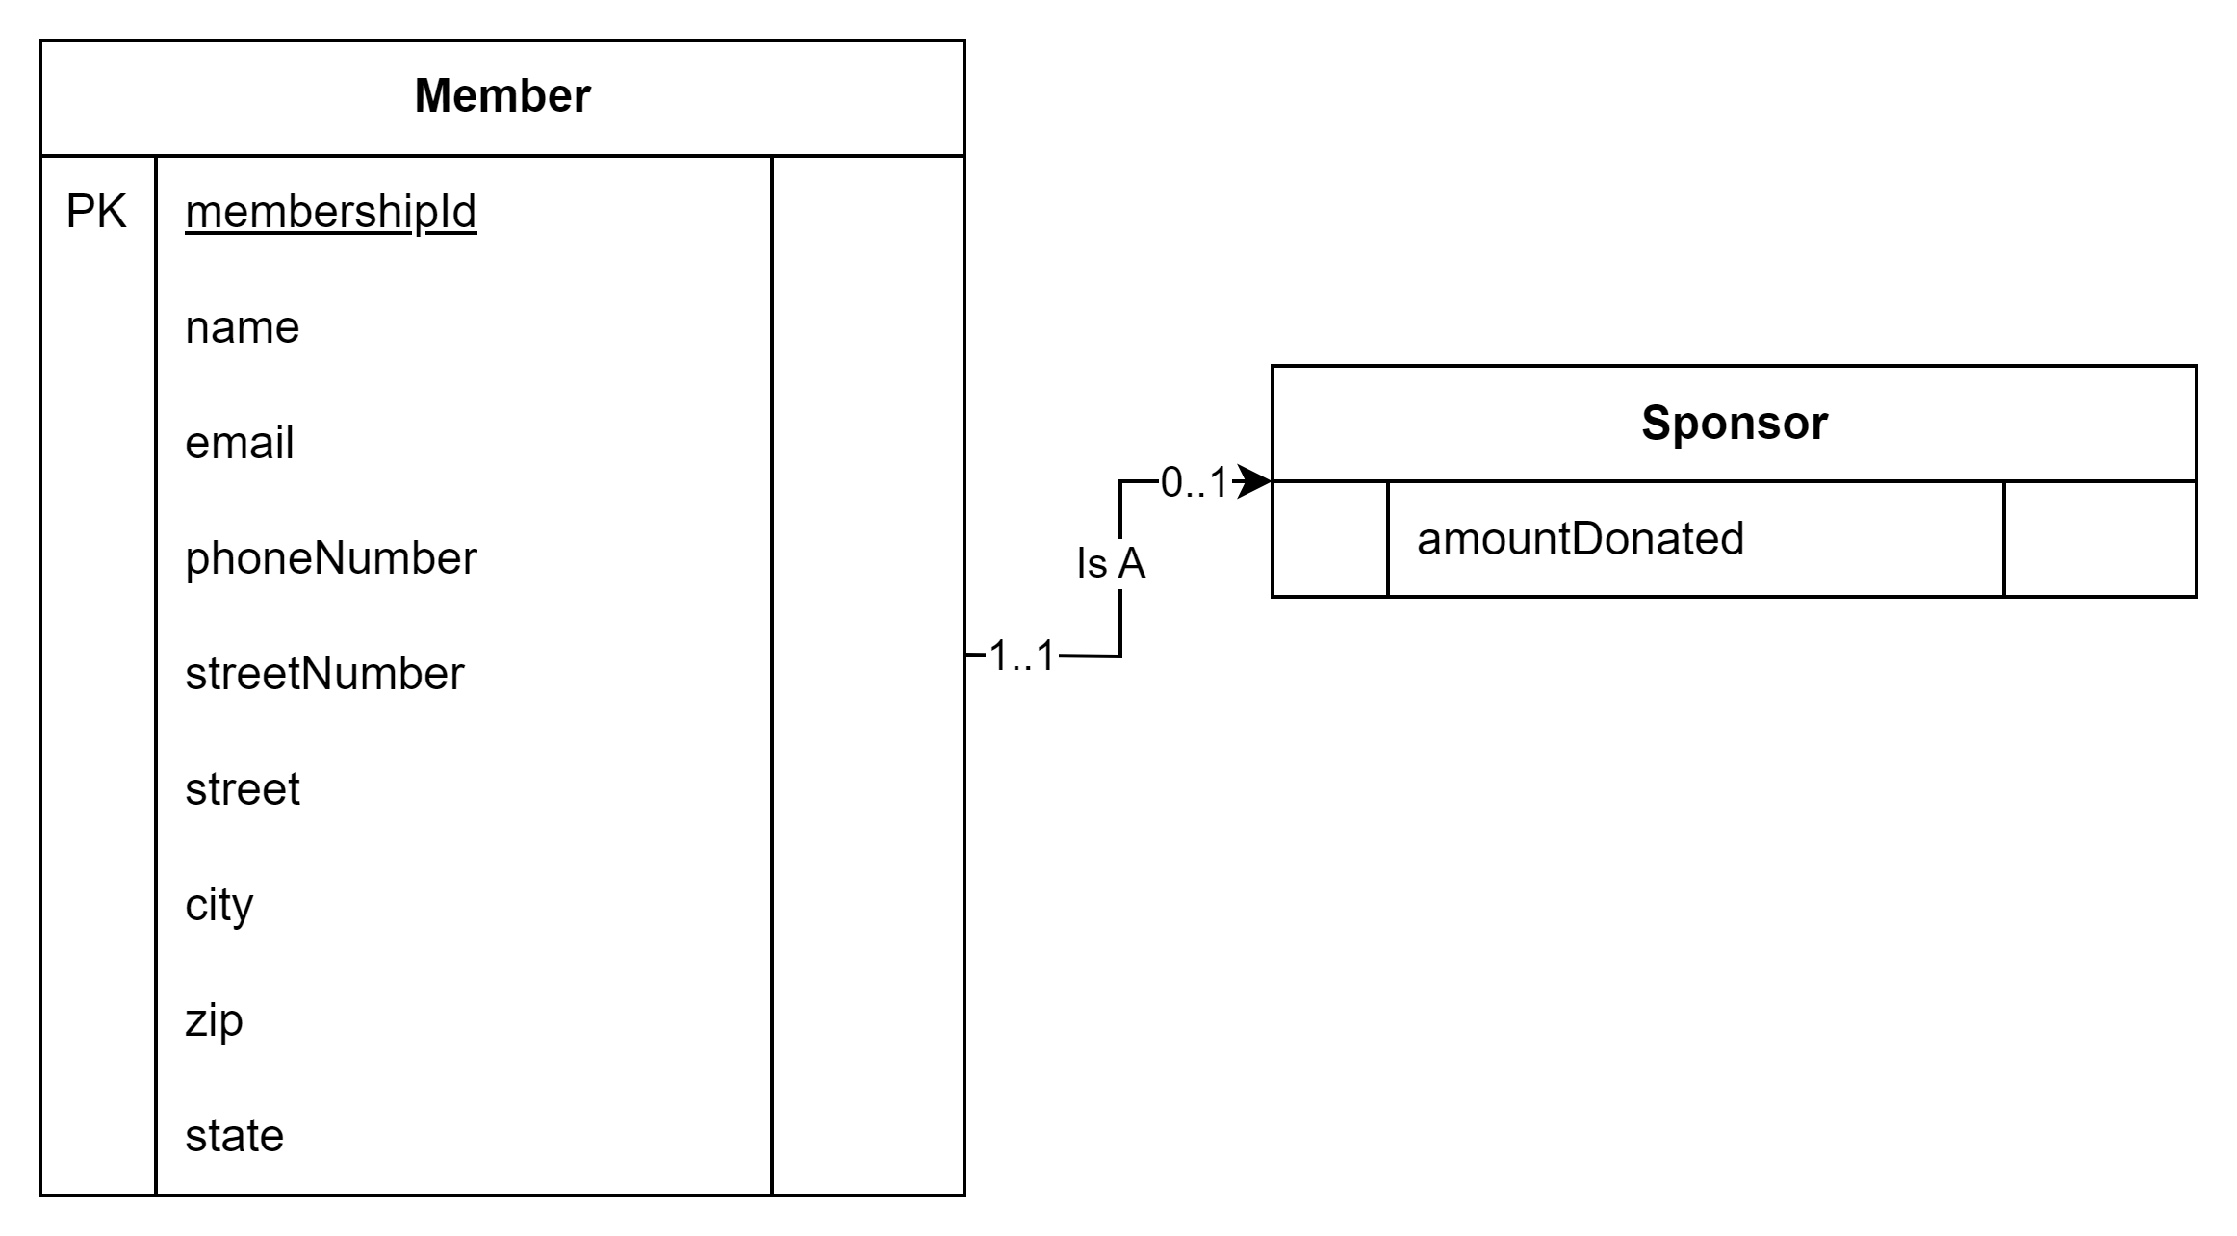
1:1
Mandatory-Mandatory: Assess merger
Mandatory-Optional: “Optional” side is the child, “Mandatory” side is parent
Optional-Optional: Pick one (which one is more mandatory)
Recursive: Add the PK to the class as an FK with a descriptive name

Slide 13
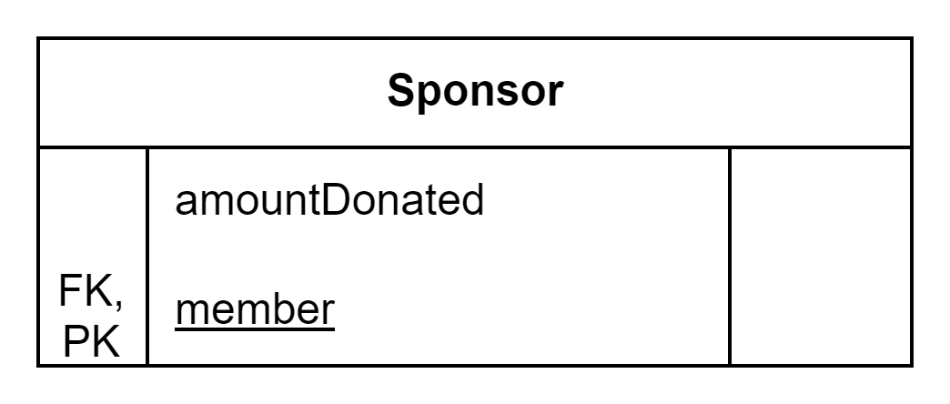
1:1

Slide 14
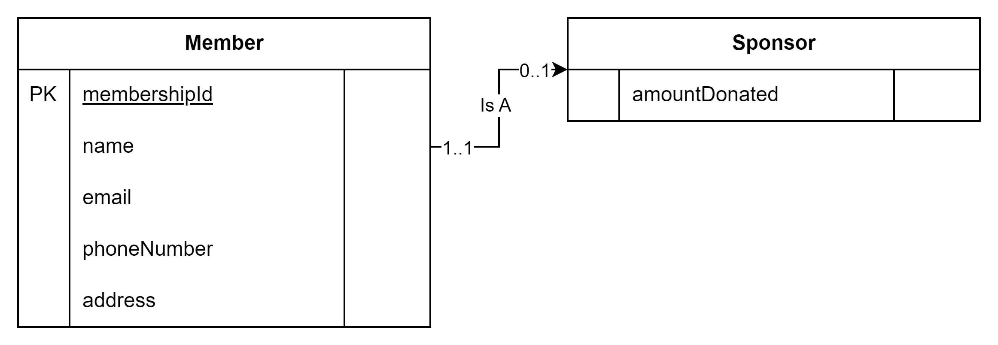
Superclass/subclass
Subclass is the child, superclass is the parent.
** probably already did this in one of the other relationships

Slide 15
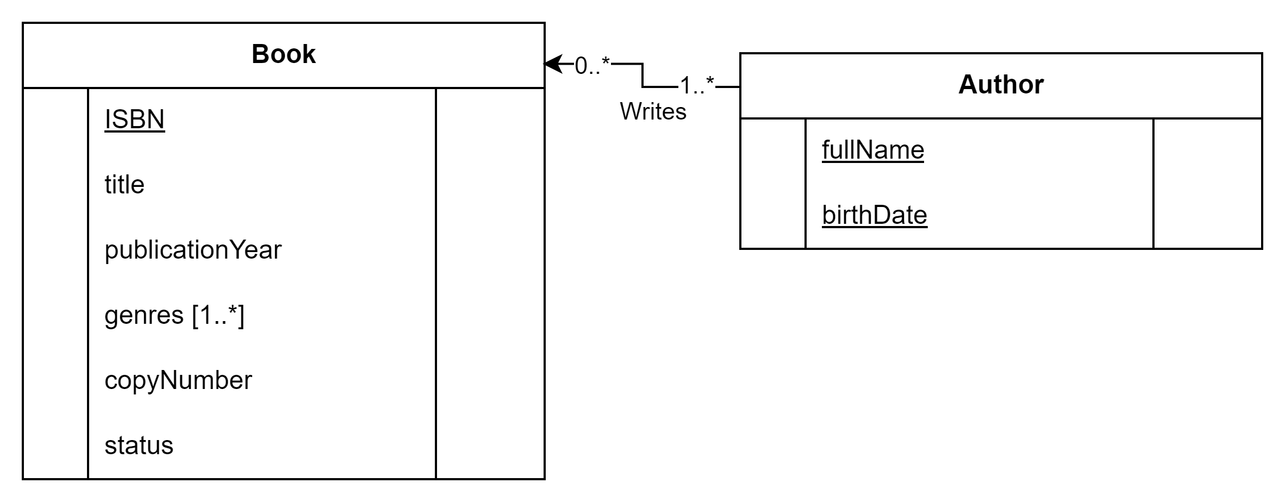
*:* relationships
Create a new class to hold the mapping
The PK from each side becomes an FK in the new class
Store any additional attributes in this new class

Slide 16
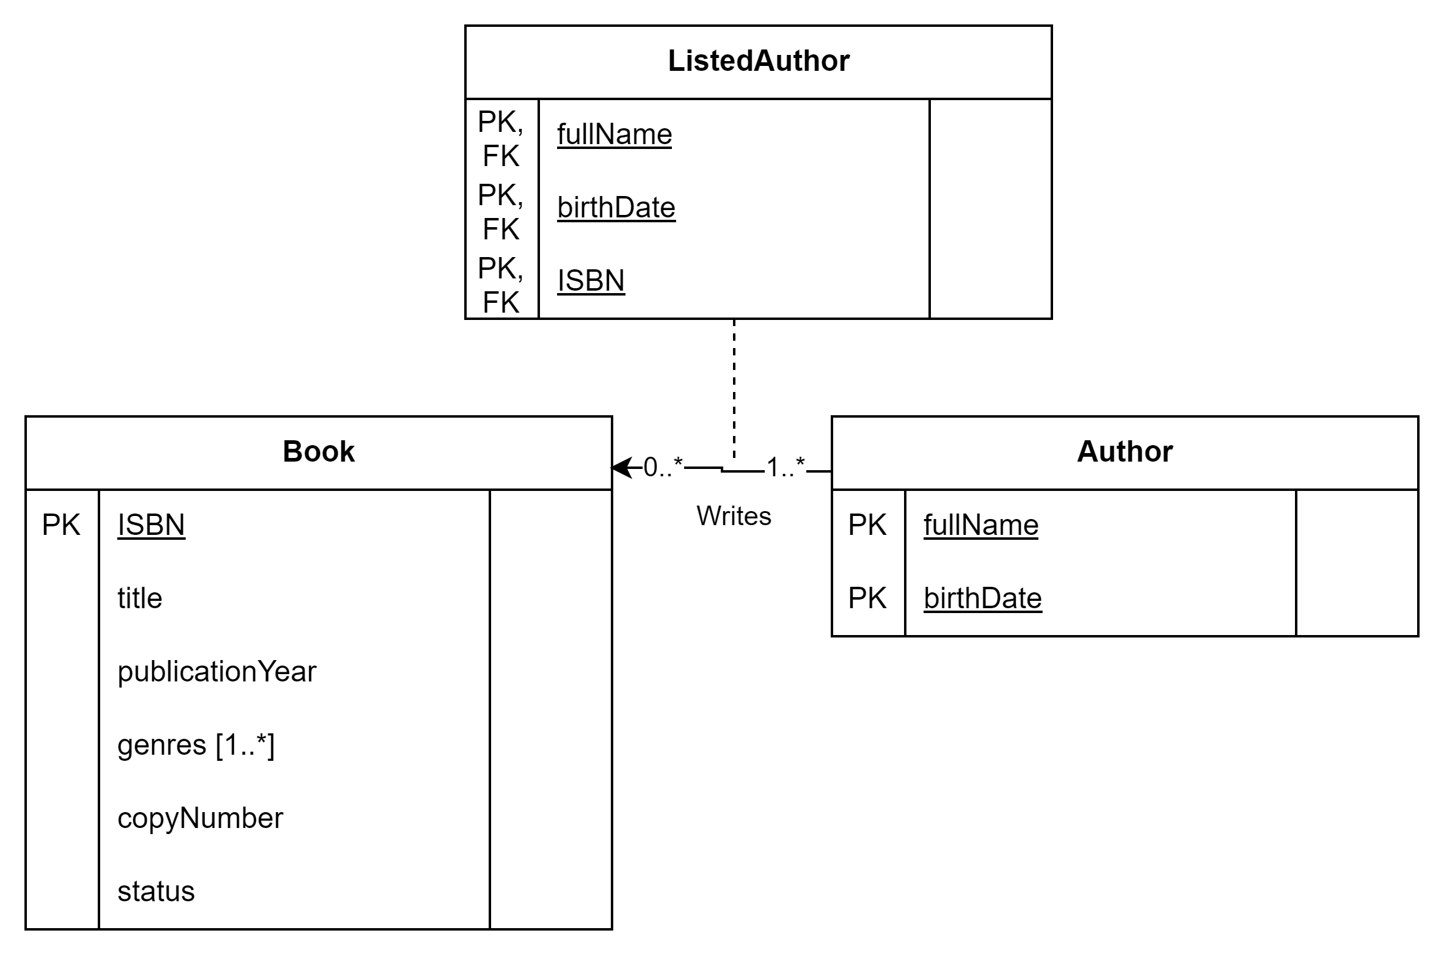
*:* relationships

Slide 17
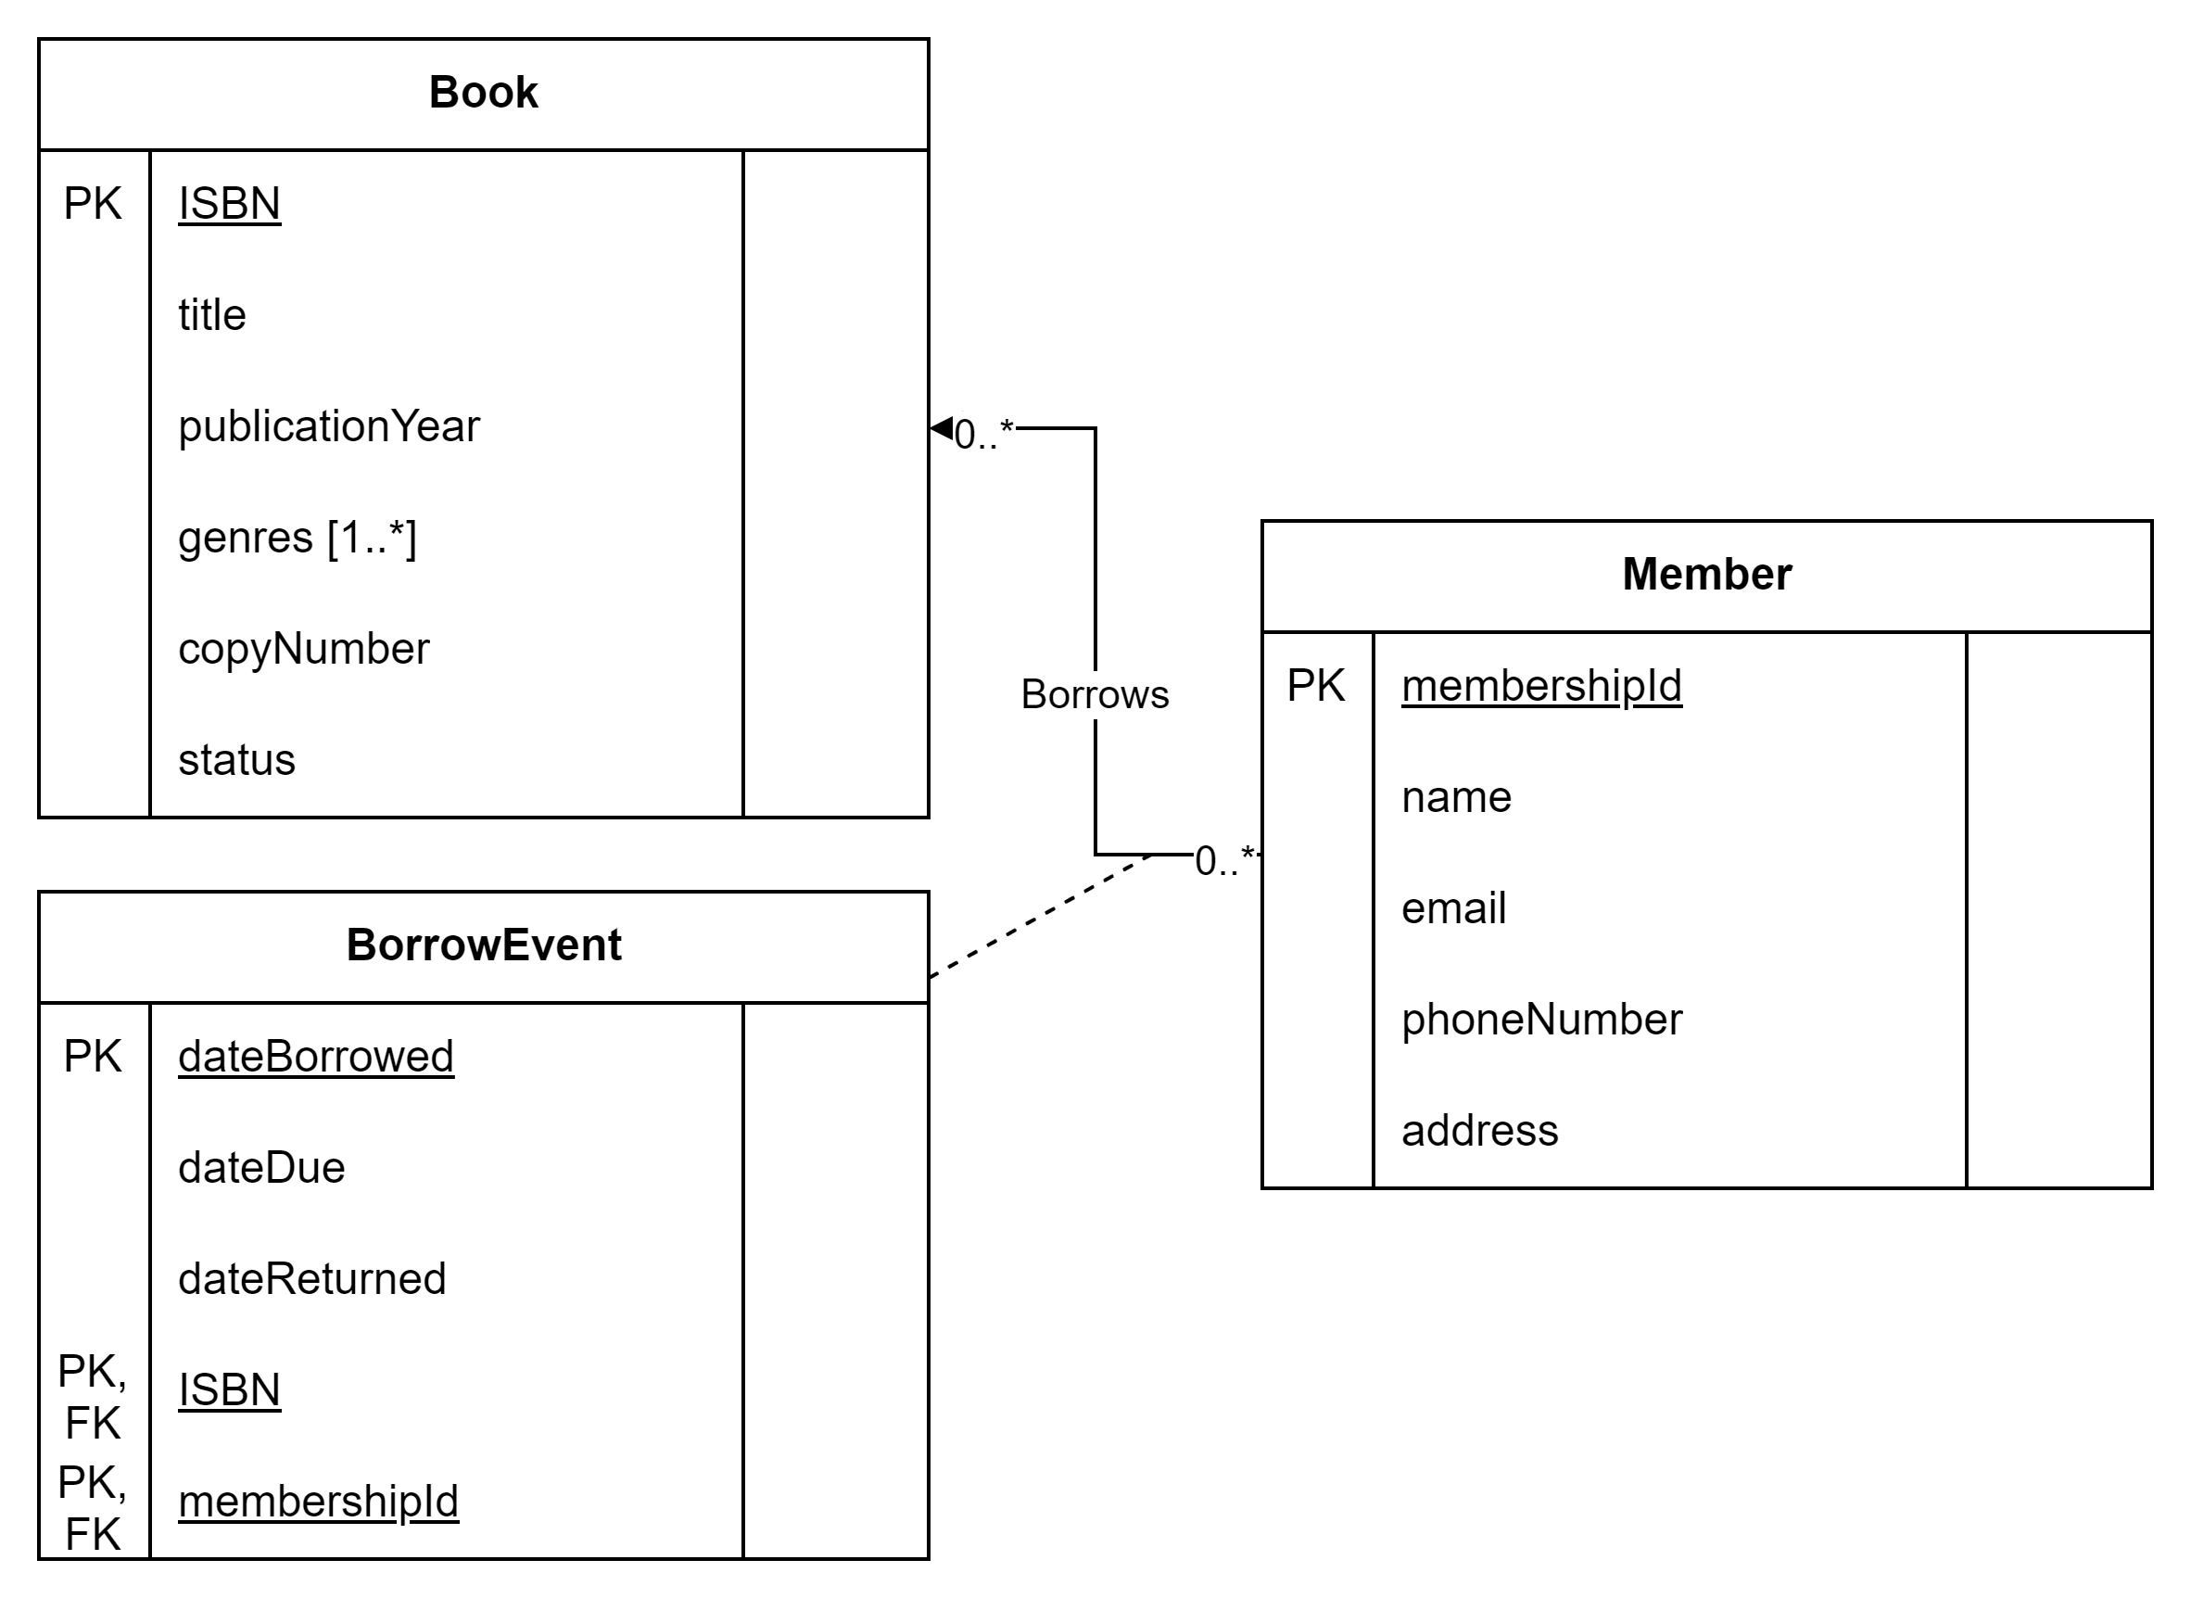
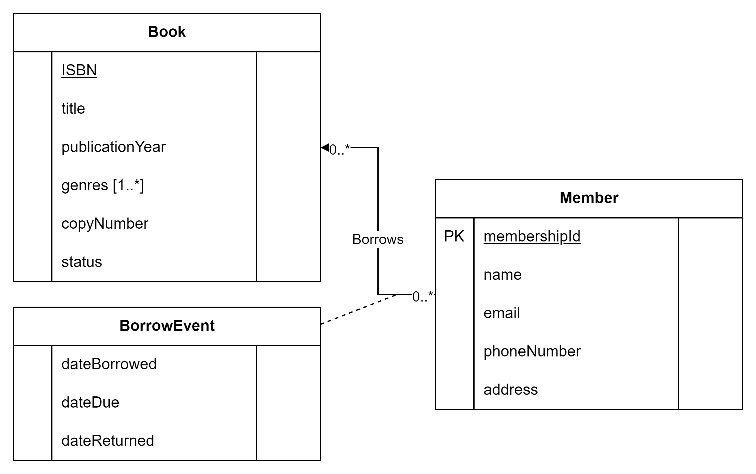
*:* relationships

Slide 18
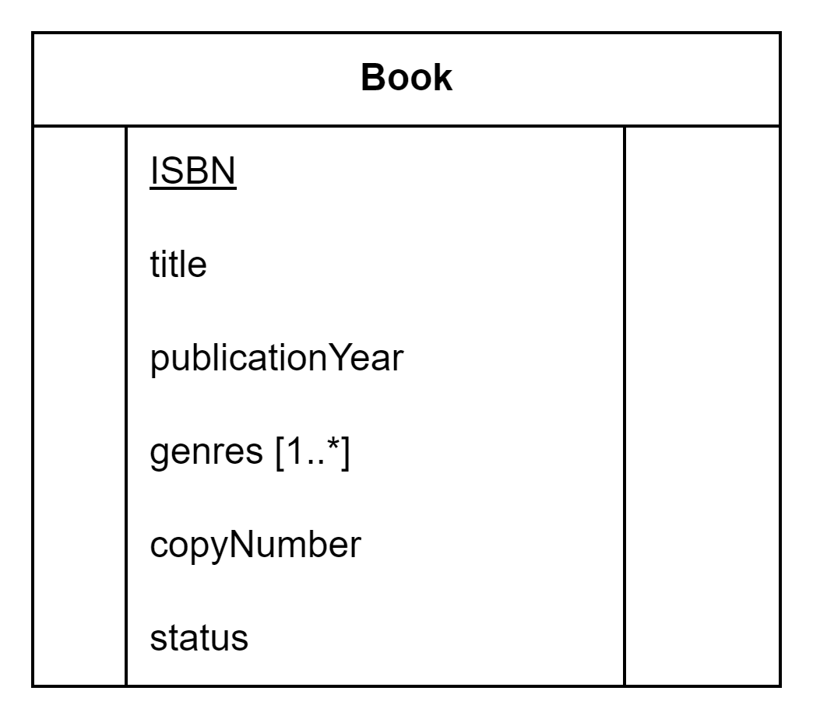
Multi-valued attributes
Create a new class for the multi-valued attribute.
PK of old class becomes FK of new class.
PK of new class is composite of PK and value

Slide 19

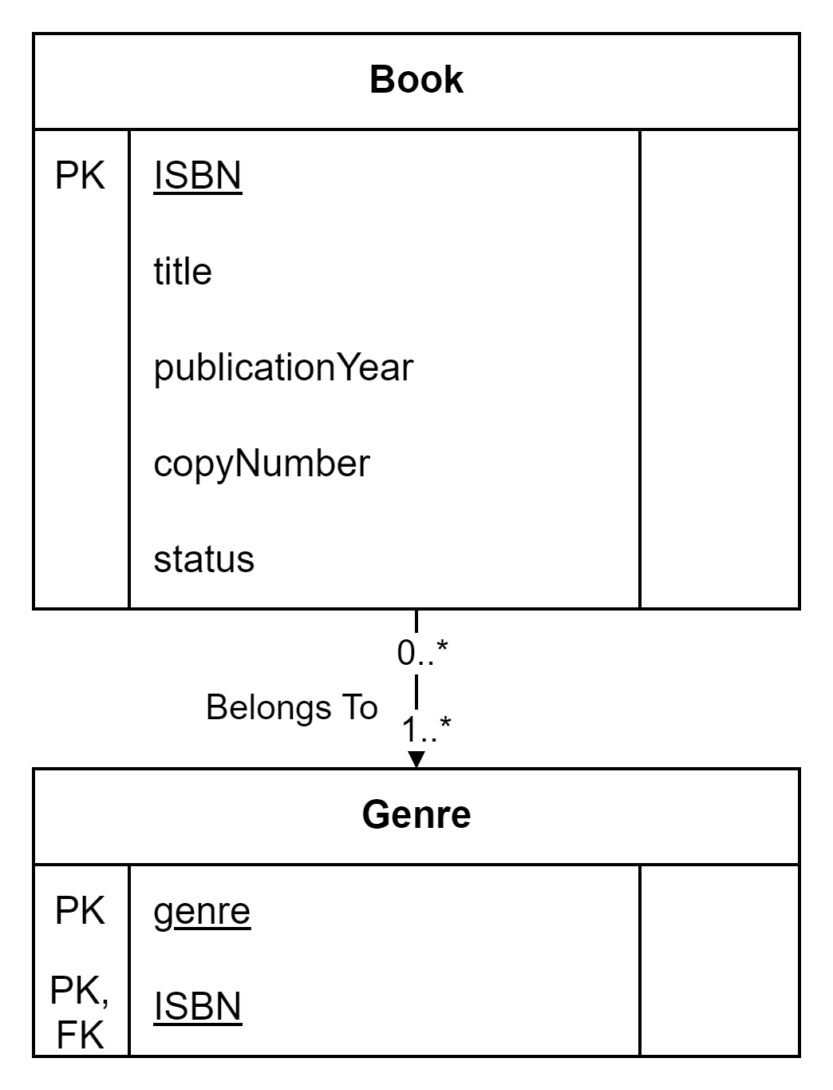
Multi-valued attributes

Slide 20
Your Turn
Take your conceptual design and convert it to a logical design
Strong entities
Weak entities
1:* relationships
1:1 relationships
Superclass/subclass
*:* relationships
Multi-valued attributes

Slide 21
Normalize…
Next lesson

